Slide 1
Chapter 4. High-Level Database Model

Slide 2
Objectives
Understand the Database Design Process
Understand data modeling basing on entity relationship
Design a suitable database adapted business requirements in reality

Slide 3
Contents
Database design process
Entity relationship model
What are entity, entity set, attribute, relationship?
Entity Relationship Diagram (ERD)
Attributes on Relationships
Weak Entities
Sub-class

Slide 4
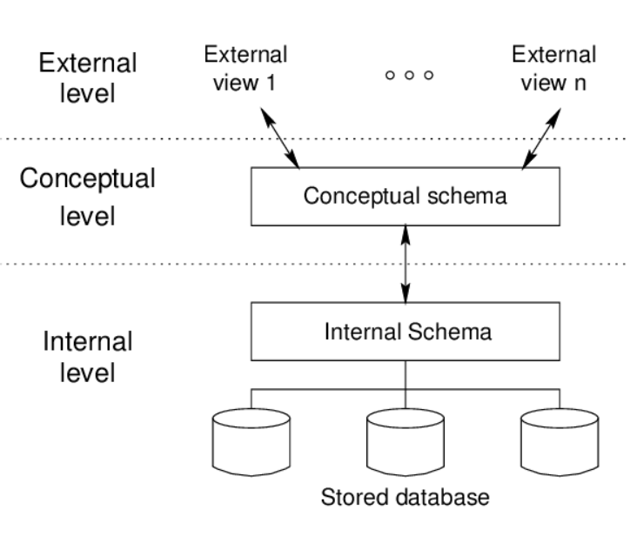
Data model - Overview
Notes:
Bieu dien the gioi thuc bang tap nho cac ky hieu
rút gọn tổ chức dữ liệu thành sự mô tả của các thực thể và các mối liên hệ giữa chúng: -> Sự mô tả của các yêu cầu thông tin mà máy tính có thể sử dụng

Slide 5
Database modeling and implementation process
Getting
User
Requirement
High-Level
Design
Relational
Database
Schema
Design
Relational DBMS
ER diagram
Relational Database Schema
Figure 4.1: The database modeling and implementation process
Notes:
Data Model - a group of conceptual tools that describes data, its relationships and semantics. It also consists of the consistency constraints that the data adheres to.

Slide 6
Steps in Database Design
Requirements Analysis
- user needs; what must database do?
Conceptual Design
- high level description (Entity Relationship diagram)
Logical Design
- translate ERD into DBMS data model
Schema Refinement
- consistency, normalization
Physical Design
- indexes, disk layout
Security Design
- who accesses what, and how
Notes:
Yeu cau ve du lieu lieu, thao tren du lieu

Slide 7
ERD – How to construct
Gather all the data that needs to be modeled.
Identify data that can be modeled as real world entities.
Identify the attributes for each entity.
Sort entity sets as weak or strong entity sets.
Sort entity attributes as key attributes, multi-valued attributes, composite attributes, derived attributes.
Identify the relations between the different entities.
Using the different symbols draw the entities, their attributes and their relationships. Use appropriate symbols while drawing attributes.

Slide 8
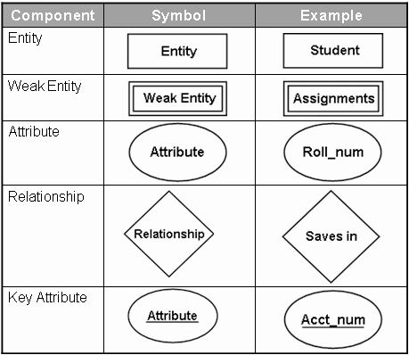
Entity Relationship Diagram - Notations

Slide 9
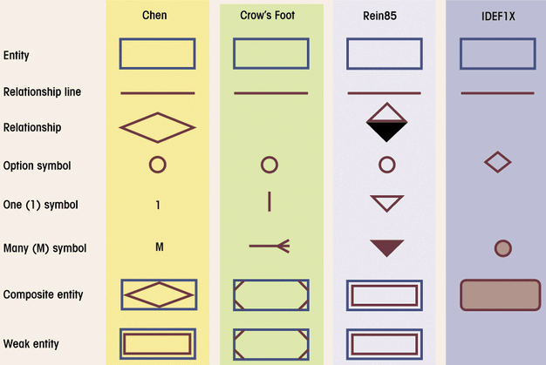
Comparison of E-R Modeling notations

Slide 10
ERD - Entity
Entity:
Real-world thing, distinguishable from other objects.
Noun phrase
Entity described by set of attributes.
Entity Set: A collection of similar entities. E.g., all employees.
All entities in an entity set have the same set of attributes. (Until we consider hierarchies, anyway!)
Each attribute has a domain.
name
ssn
lot
Employee

Slide 11
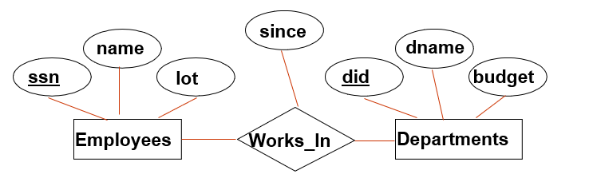
Relationship
Relationship: Association among two or more entities
relationships can have their own attributes (descriptive attributes).
verb phrases
1-1
1-M/M-1
M-M
Degree Constraints
Recursive relationship
Unary, Binary, Ternary relationship
A referential integrity constraints
A value appearing in one context must also appear in another

Slide 12
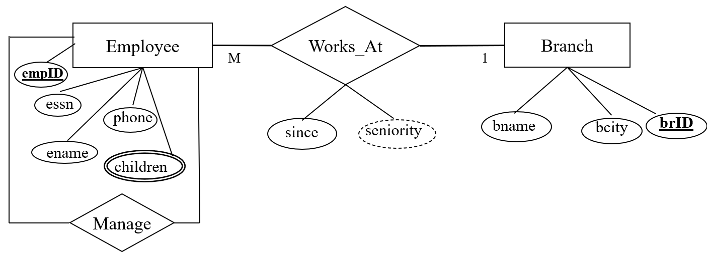
Type of Attributes
Key attribute
Multivalued attribute
Derived attribute
Composite attribute
EmpID
children
seniority
Address
Address

Slide 13
Let’s study them with an Entity Relationship Diagram Example
In a university, a Student enrolls in Courses. A student must be assigned to at least one or more Courses. Each course is taught by a single Professor. To maintain instruction quality, a Professor can deliver only one course

Slide 14
Weak Entity Sets
Consider the relationship
An entity set’s key to be composed of attributes, some or all of which belong to another entity set. Such an entity set is called a weak entity set.
number
crewChief
name
address
Crews
Unit-of
Studios
M
1
Weak entity set
Supporting entity set
1

Slide 15
Requirements for Weak Entity Sets
R is a relationship from E to F
R is called supporting relationship if
R must be a binary, many-one relationship from E to F
R must have referential integrity from E to F
The attributes that F supplies for the key of E must be key attributes of F

Slide 16
Weak Entity Sets
Example weak entity set
Contracts
salary
M
Studio-of
Movie-of
Star-of
1
1
1
Stars
Studios
Movies
genre
year
length
name
addr
title
name
addr
Notes:
hop dong, giao keo

Slide 17
Subclasses in E/R Model
Consider Cartoons and Murder Mysteries are the special kinds of movies, with some special properties
to Stars
length
title
year
genre
Movies
Voices
isa
isa
weapon
Cartoons
Murder Mysteries

Slide 18
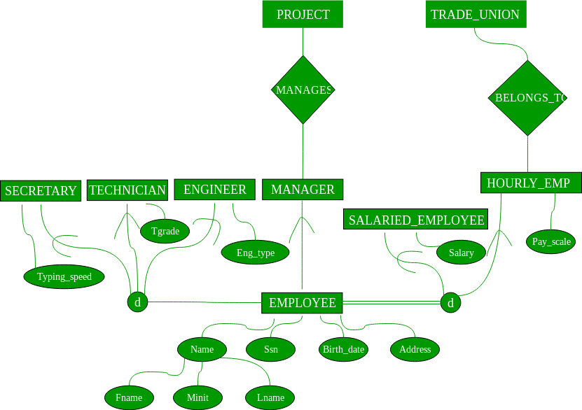

Slide 19
Example COMPANY Database – Construct ERD
Requirements of the Company (oversimplified for illustrative purposes)
The company is organized into DEPARTMENTs. Each department has a name, number and an employee who manages the department. We keep track of the start date of the department manager.
Each department controls a number of PROJECTs. Each project has a name, number and is located at a single location.

Slide 20
Example COMPANY Database (Cont.)
We store each EMPLOYEE’s social security number, address, salary, sex, and birthdate. Each employee works for one department but may work on several projects. We keep track of the number of hours per week that an employee currently works on each project. We also keep track of the direct supervisor of each employee.
Each employee may have a number of DEPENDENTs. For each dependent, we keep track of their name, sex, birthdate, and relationship to employee.

Slide 21
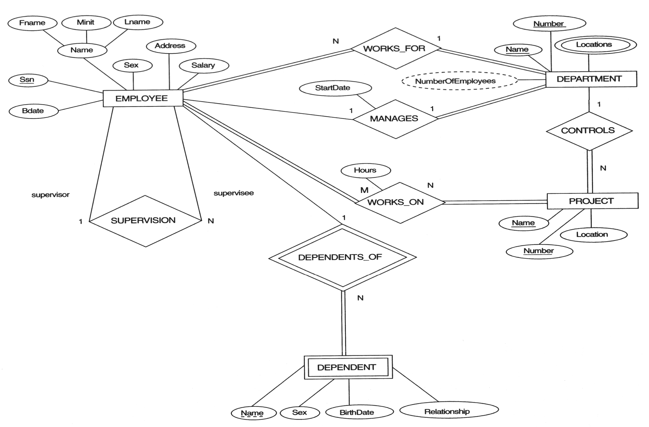
Database company

Slide 22
From ER Diagram to Relational Model
Overview:
1 entity = 1 relation
attributes of entity ~ attributes of relation
key of entity ~ key of relation
Convert 1-1 relationship
Convert 1-M relationship
Put key attribute of one-side to M-side
Convert M-M relationship
Generate 1 relation, Primary key of this relation combined from two relations. Attributes of new relation ~ attributes of relationship (if have)

Slide 23
From ER Diagram to Relational Model Convert 1-1 relationship
For one-to-one relationship w/out total lx/E xoor4tui40tru
deb
Build a table with two columns, one column for each participating entity set’s primary key. Add successive columns, one for each descriptive attributes of the relationship set (if any).
For one-to-one relationship with one entity set having total participation
Augment one extra column on the right side of the table of the entity set with total participation, put in there the primary key of the entity set without complete participation as per to the relationship.

Slide 24
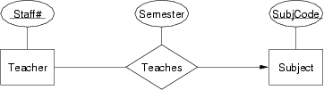
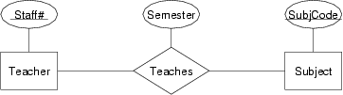
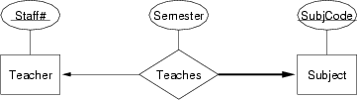

Slide 25

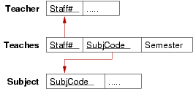


Slide 26
Convert N-ary Relationship Set
P-Key1
D-Attribute
A-Key
E-Set 1
P-Key2
A relationship
Another Set
E-Set 2
P-Key3
E-Set 3
P-Key1 | P-Key2 | P-Key3 | A-Key | D-Attribute
9999 | 8888 | 7777 | 6666 | Yes
1234 | 5678 | 9012 | 3456 | No
* Primary key of this table is P-Key1 + P-Key2 + P-Key3

Slide 27
Representing Composite Attribute
Relational Model Indivisibility Rule Applies
One column for each component attribute
NO column for the composite attribute itself
SSN
Name
SSN | Name | Street | City
9999 | Dr. Smith | 50 1st St. | Fake City
8888 | Dr. Lee | 1 B St. | San Jose
Professor
Address
Street
City

Slide 28
Representing Multivalue Attribute
For each multivalue attribute in an entity set/relationship set
Build a new relation schema with two columns
One column for the primary keys of the entity set/relationship set that has the multivalue attribute
Another column for the multivalue attributes. Each cell of this column holds only one value. So each value is represented as an unique tuple
Primary key for this schema is the union of all attributes

Slide 29
Example – Multivalue attribute
SID
Name
The primary key for this table is Student_SID + Children, the union of all attributes
Children
Student
Major
GPA
Stud_SID | Children
1234 | Johnson
1234 | Mary
5678 | Bart
5678 | Lisa
5678 | Maggie
SID | Name | Major | GPA
1234 | John | CS | 2.8
5678 | Homer | EE | 3.6

Slide 30
Representing Class Hierarchy
Two general approaches depending on disjointness and completeness
For non-disjoint and/or non-complete class hierarchy:
create a table for each super class entity set according to normal entity set translation method.
Create a table for each subclass entity set with a column for each of the attributes of that entity set plus one for each attributes of the primary key of the super class entity set
This primary key from super class entity set is also used as the primary key for this new table

Slide 31
Example
SSN
Name
Person
SID
Status
Gender
ISA
Student
Major
GPA
SSN | Name | Gender
1234 | Homer | Male
5678 | Marge | Female
SSN | SID | Status | Major | GPA
1234 | 9999 | Full | CS | 2.8
5678 | 8888 | Part | EE | 3.6

Slide 32
Representing Class Hierarchy
Two general approaches depending on disjointness and completeness
For disjoint AND complete mapping class hierarchy:
DO NOT create a table for the super class entity set
Create a table for each subclass entity set include all attributes of that subclass entity set and attributes of the superclass entity set
Simple and Intuitive enough, need example?

Slide 33
Example
SSN
Name
No table created for superclass entity set
SJSU people
ISA
SID
Student
Faculty
Disjoint and Complete mapping
Major
GPA
Dept
SSN | Name | SID | Major | GPA
1234 | John | 9999 | CS | 2.8
5678 | Mary | 8888 | EE | 3.6
SSN | Name | Dept
1234 | Homer | C.S.
5678 | Marge | Math

Slide 34
Representing Aggregation
Name
SSN
Name
M
Advisor
1
Student
Professor
Dept
SID
Name
member
Primary Key of Advisor
Dept
SID | Code
1234 | 04
5678 | 08
Code
Primary key of Dept
Notes:
Tong hop

Slide 35
From E/R Relationship to Relations
Stars
Contracts
Movies
Studio
of star
Producing
studio
Studios
Contracts(starName, title,year, studioOfStar_name, producingStudio_name)

Slide 36
Combining Relations
name
address
Movies(title,year,length,genre)
Owns(title,year,studioName)
Stars
title
year
Stars-in
name
Movies
Studios
Owns
length
genre
address
Movies(title,year,length,genre,studioName)
Suppose an entity set E and a many-one relationship R from E to F. We can combine two relations E and R into one relation with a schema consisting of:
All attributes of E,
The key attributes of F, and all own attributes belonging to relationship R

Slide 37
Handling Weak Entity Sets
If W is a weak entity set, construct for W a relation whose schema consists of:
All attributes of W
All own attributes of supporting relationships for W
For each supporting relationship for W, say a many-one relationship from W to entity set E, all the key attributes of E
Rename attributes, if necessary, to avoid name conflicts
Do not construct a relation for any supporting relationship for W
number
crewChief
name
address
Crews
Unit-of
Studios
Studios(name,address)
Crews(number,crewChief,studioName)

Slide 38
SUBCLASS STRUCTURES TO RELATIONS

Slide 39
Converting Subclass Structures to Relations
How we convert this structure to relations?
to Stars
length
title
year
genre
Movies
Voices
isa
isa
weapon
Cartoons
Murder Mysteries

Slide 40
Converting Subclass Structures to Relations
The principal conversion strategies
Follow E/R viewpoint
For each entity set E in the hierarchy, create a relation that includes the key attributes from the root and any attributes belong to E
Treat entities as object-oriented
For each possible subtree that includes the root, create one relation, whose schema includes all the attributes of all the entity sets in the subtree
Use null values
Create only one relation with all attributes of all entity sets in the hierarchy. Each entity is represented by one tuple, and that tuple has a NULL value for whatever attributes the entity does not have

Slide 41
E/R Style Conversion
to Stars
length
title
year
genre
Movies
Voices
isa
isa
weapon
Cartoons
Murder Mysteries
Movies(title,year,length,genre)
MurderMysteries(title,year,weapon)
Cartoons(title,year) ← remove
Voices(title,year,starName)

Slide 42
An Object-Oriented Approach
to Stars
length
title
year
genre
Movies
Voices
isa
isa
weapon
Cartoons
Murder Mysteries
Movies(title,year,length,genre)
MoviesC(title,year,length,genre)
MoviesMM(title,year,length,genre,weapon)
MoviesCMM(title,year,length,genre,weapon)

Slide 43
Using Null Values
to Stars
length
title
year
genre
Movies
Voices
isa
isa
weapon
Cartoons
Murder Mysteries
Movie(title,year,length,genre,weapon)

Slide 44
Unified Modeling Language –self studying
Introduction
UML is designed to model software in an object-oriented style, but has been adapted as a database modeling language
UML offers much the same capabilities as the E/R model, with the exception of multi-way relationships, only binary relationships in UML.

Slide 45
UML vs. E/R Model
UML | E/R Model
Class | Entity Set
Association | Binary relationship
Association class | Attributes on a relationship
Subclass | is-a hierarchy
Aggregation | Many-one relationship
Composition | Many-one relationship with referential integrity
Figure 4.34: Comparison between UML and E/R terminology

Slide 46
UML Classes
Movies
title PK year PK length genre init() modify()
Class’ name
State
Behavior

Slide 47
Associations
Consider an associations between Movies, Stars, and Studios in UML
Studios
name PK
address
0..1
Owns
Movies
title PK
year PK
length
genre
0..*
Stars
name PK
address
0..*
0..*
Stars-in

Slide 48
Associations
Comparison with E/R Multiplicities
E/R UML
0..* 0..*
0..* 0..1
0..* 1..1

Slide 49
Self-Associations
An association can have both ends at the same class; such an association is called a self-association
Example
Movies
title PK
year PK
length
genre
0..1
theOriginal
0..*
theSequel

Slide 50
Association Classes
Movies
title PK
year PK
length
genre
Stars
name PK
address
0..*
Stars-in
0..*
Compensation
salary
residuals

Slide 51
Subclasses in UML
Consider Movies and its three subclasses
Figure 4.40: Cartoons and murder mysteries as disjoint subclasses of movies
Movies
title PK
year PK
length
genre
Murder Mysteries
weapon
Cartoons
Cartoon-Murder Mysteries
weapon

Slide 52
Aggregations and Compositions
MovieExecs
cert# PK
name
address
networth
Movies
title PK
year PK
length
genre
Studios
name PK
address
Presidents
1..*
0..1
0..1
1..1
Figure 4.41: An aggregation from Movies to Studios and
a composition from Presidents to Studios

Slide 53
UML-to-Relations Basics
Classes to Relations
For each class, create a relation
name is the name of the class
attributes are the attributes of the class
Associations to Relations
For each association, create a relation
name is the name of that association
attributes are the key attributes of the two connected classes

Slide 54
UML-to-Relations Basics
Studios
name PK
address
0..1
Owns
Movies
title PK
year PK
length
genre
0..*
Stars
name PK
address
0..*
0..*
Stars-in
Movies(title,year,length,genre)
Stars(name,address)
Studios(name,address)
Stars-In(movieTitle,movieYear,starName)
Owns(movieTitle,movieYear,studioName)

Slide 55
From UML Subclasses to Relations
We can use any of the three strategies outlined for E/R to convert a class and its subclasses to relations
E/R-style: each subclass’ relation stores only its own attributes, plus key
OO-style: relations store attributes of subclass and all super-classes
Nulls: One relation, with NULL’s as needed

Slide 56
From Aggregations and Composition to Relation
No relation for the aggregation or composition
Add to the relation for the class at the non-diamond end the key attribute(s) of the class at the diamond end
In the case of an aggregation, it is possible that these attributes can be null

Slide 57
From Aggregations and Composition to Relation
MovieExecs
cert# PK
name
address
networth
MovieExecs(cert#,name,address,netWorth)
Presidents(cert#,studioName)
Movies(title,year,length,genre,studioName)
Studios(name,address)
Movies
title PK
year PK
length
genre
Studios
name PK
address
President
1..*
0..1
0..1
1..1

Slide 58
The UML Analog of Weak Entity Sets
We use the composition, which goes from the weak class to the supporting class, for a weak entity set
Example:
Studios(name,address)
Crews(number,crewChief,studioName)
Crews
number PK
crewChief
Studios
name PK
address
0..*
1..1
PK

